Slide 1
Design Patterns
课程：软件工程方法与实践
董威
wdong@nudt.edu.cn
Department of Computer Science
National University of Defense Technology

Slide 2
Lecture Outline
Design Pattern Overview
GRASP
The Gang of Four
Design Pattern Example 1 - Abstract Factory
Design Pattern Example 2 - Observer

Slide 3
Design Pattern Overview

Slide 4
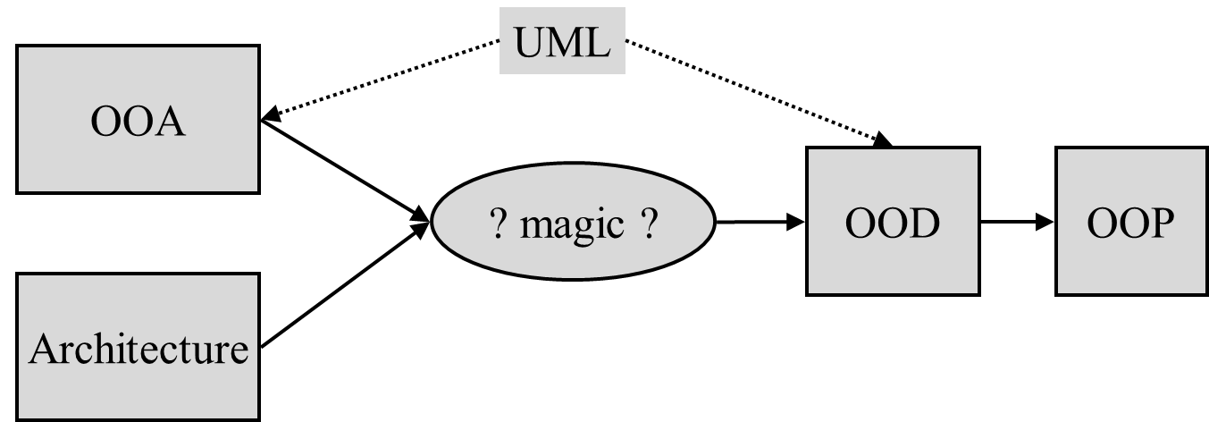
The Problem
There is no step-by-step method to get from the OOA to an OOD.
  At least the OOA gives you the problem domain component in a fairly direct manner.
  For the rest, you need experience.

Slide 5
What is a Pattern?
Inspired by the work of Christopher Alexander, who first described patterns in Architecture:
“Each pattern describes a problem which occurs over and over again in our environment, then describes the core of the solution to that problem, in such a way that you can use this solution a million times over, without ever doing it the same way twice”
“An idea that has been useful in one practical context and will probably be useful in others”

Slide 6
Design Patterns
Design Patterns: Elements of Reusable Object-Oriented Software (1995)
  Erich Gamma
  Richard Helm
  Ralph Johnson
  John Vlissides (a.k.a. The Gang of Four)
Use object modelling techniques to represent common solutions to problems in the design of OO software, taken from multiple actual systems

Slide 7
A Design Pattern is
SMART - an elegant solution not obvious to a novice
GENERIC - not dependent upon a system, programming language or application domain
WELL-PROVEN - has been identified from real OO systems
SIMPLE - is usually quite small, involving only a handful of classes
REUSABLE - is documented in such a fashion that it is easy to reuse
OBJECT-ORIENTED - built with OO mechanisms such as classes, objects, generalization and polymorphism

Slide 8
A Design Pattern has
a Pattern Name - a handle we can use to describe a design problem, its solutions and consequences
the Problem - describes when to apply the pattern. It explains the problem and its context
the Solution - describes the elements which make up the solution and their relationships
the Consequences - the results and trade-offs of using the design pattern

Slide 9
Design Patterns are Specified as
Pattern name and classification
Intent
  What does it do? What’s its rationale
Also knows as
Motivation
  A use scenario
Applicability
  In what situations can you apply it? How can you recognize these situations.
Structure
  UML
Participants
Collaborations
Consequences
  Trade-offs in applying this pattern
Implementation
  Any implementation tips when applying the pattern
Sample code
Known uses
Related patterns

Slide 10
Using Design Patterns
When faced with a design problem, a good designer will look for a published pattern that
  solves that problem
  or a closely related one
Step 1: Understand the pattern
Step 2: Use the pattern.
  Either re-use it as is, adapting it to the specific situation
    adaptation is always required
  Use it as inspiration to come up with something that
    either fits your problem more precisely
    is a better solution than the published pattern

Slide 11
GRASP

Slide 12
General Responsibility Assignment Software Pattern
They describe fundamental principles of object design and responsibility assignment, expressed as patterns.
  Expert
  Creator
  Low Coupling
  High Cohesion
  Controller
  Polymorphism
  Pure fabrication
  Indirection
  Don’t talk to stranger

Slide 13
(1) Expert
Problem
  What is a general principle of assigning responsibilities to objects?
Solution
  Assign a responsibility to the information expert – the class that has the information necessary to fulfill the responsibility.
Example: Assign calculation of the grand total of a sale (getTotal) in NextGen POS
  Question
    Who should be responsibility for knowing the grand total of a sale?
  We have
    Domain Model: the conceptual classes of the real-world domain.
    Design Model: the software classes
  Searching the classes to find out a responsible class
    If there are relevant classes in the Domain Model, look there first.
    Else, look in Design Model, and attempt to use (or expand) its representations to inspire the creation of corresponding design classes.

Slide 14
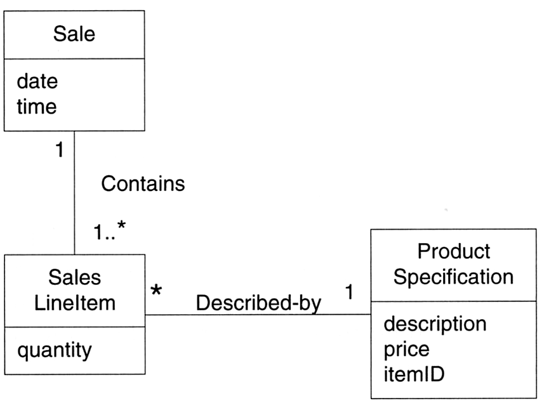
Searching Domain Model
What information is needed to determine the grand total?
  Necessary to know about all the SalesLineItem instances of a sale, and the sum of their subtotal.
  It is the Sale instance. The Sale is the information expert.

Slide 15
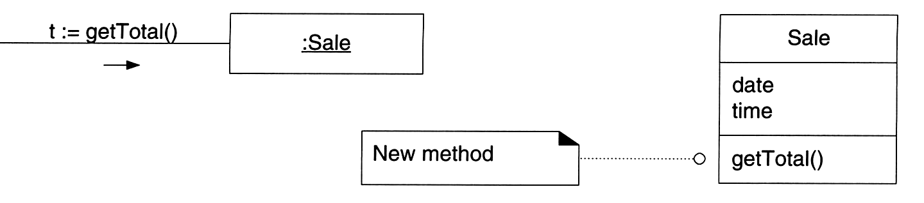
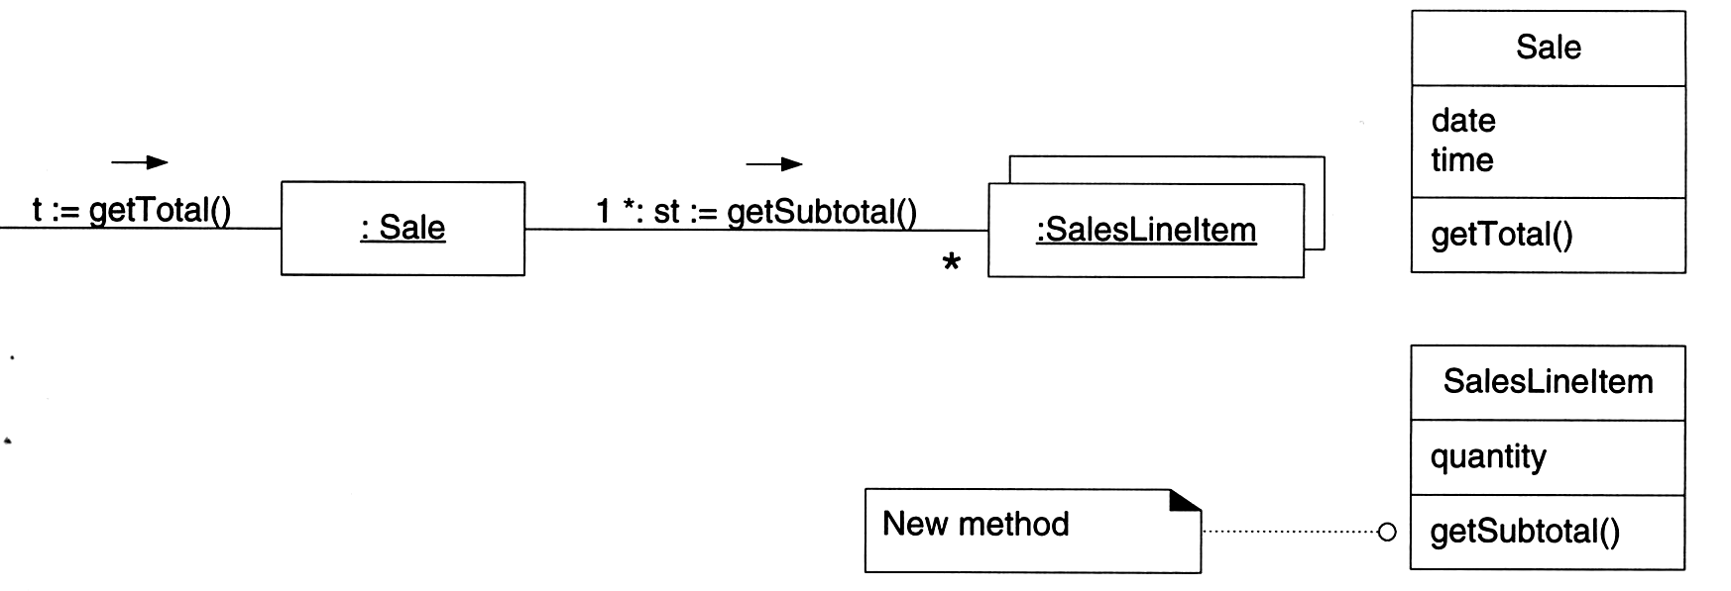
Drawing interaction and class diagrams
Drawing of diagrams in order to assign responsibilities to objects
What information is needed to determine the line item subtotal?
  SalesLineItem.quantity
  ProductSpecification.price

Slide 16
Drawing interaction and class diagrams
A SalesLineItem needs to know the product price.
The ProductSpecification is an information expert on answering its price.

Slide 17
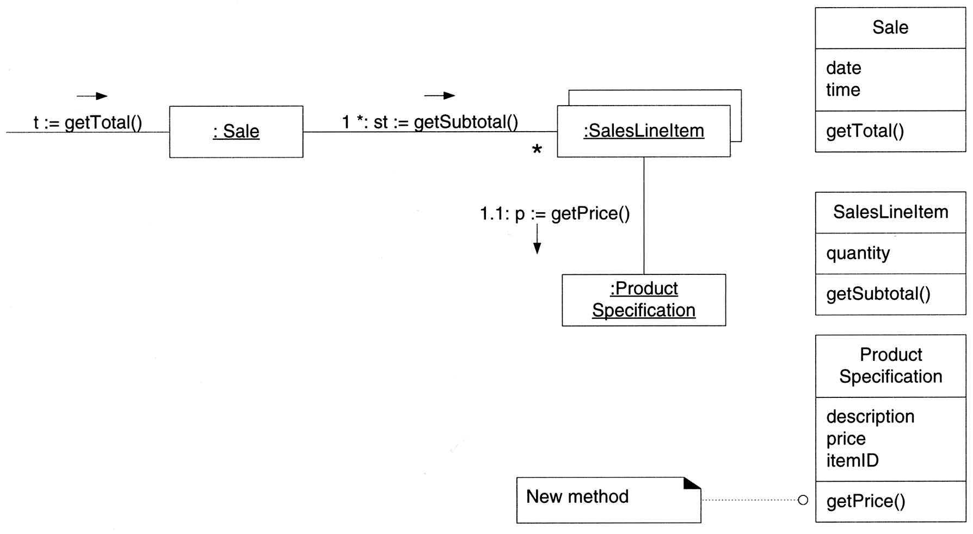
Drawing interaction and class diagrams - summary
Design Class | Responsibility
Sale | Knows sale total
SalesLineItem | Knows line item subtotal
ProductSpecification | Knows product price
Calculating the Sale total.

Slide 18
Discussion and contradictions
Discussion
  Often requires information that is spread across different classes of objects.
    Need to interact via messages to share the work.
  The Information Expert pattern has a real-world analogy.
Contradictions
  There are situations where a solution suggested by Expert is undesirable, usually because of problems in coupling and cohesion.
  Example: Who should be responsible for saving a Sale in a database?
    Information expert → Sale class
    Each class must have its own services to save itself in a database.
    But this leads to problems in cohesion, coupling, and duplication.

Slide 19
(2) Creator
Problem
  Who should be responsible for creating a new instance of some class?
Solution
  Assign class B the responsibility to create an instance of class A if one or more of the following is true :
    B aggregates A objects
    B contains A objects
    B records instances of A objects
    B closely uses A objects
    B has the initializing data that will be passed to A when it is created (thus B is an Expert with respect to creating A).
  B is a creator of A objects.
Example: who should be responsible for creating a SalesLineItem instance?
  Look for a class that aggregates, contains, and so on, SalesLineItem instances.

Slide 20
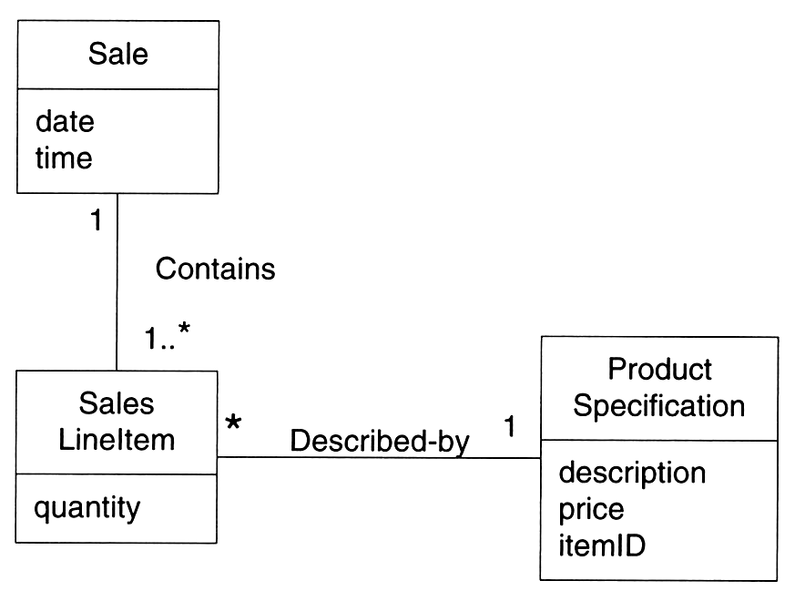
Finding Creator
Partial domain model.
Since a Sale contains many SalesLineItem objects, the Creator pattern suggests that Sale is a good candidate to have the responsibility of creating SalesLineItem instances.

Slide 21
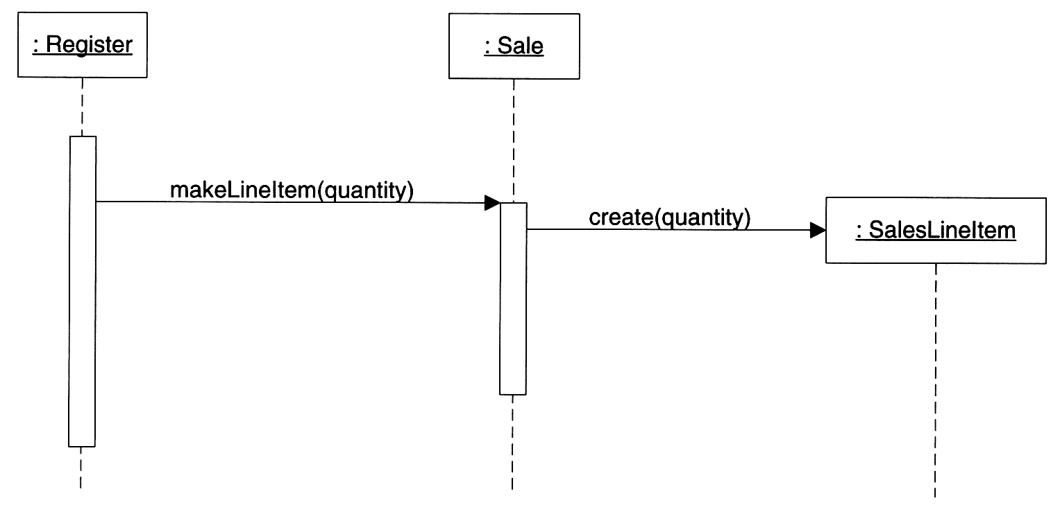
Drawing object interactions
Creating a SaleLineItem
Contradictions
  Often, creation requires significant complexity.
    Using recycled instances
    Conditionally creating an instance from one of a family of similar classes
  In these cases, it is desirable to delegate creation to a helper class called a Factory.

Slide 22
(3) Low Coupling
Solution
  Assign a responsibility so that coupling remains low.
Problem
  How to support low dependency, low change impact, and increased reuse?
Coupling
  A measure of how strongly one element is connected to, has knowledge of, or relies on other elements.
A class with high coupling relies on many other classes.
Problems of high coupled classes
  Changes in related classes force local changes.
  Harder to understand in isolation.
  Harder to reuse because its use requires the additional presence of the classes on which it is dependent.

Slide 23
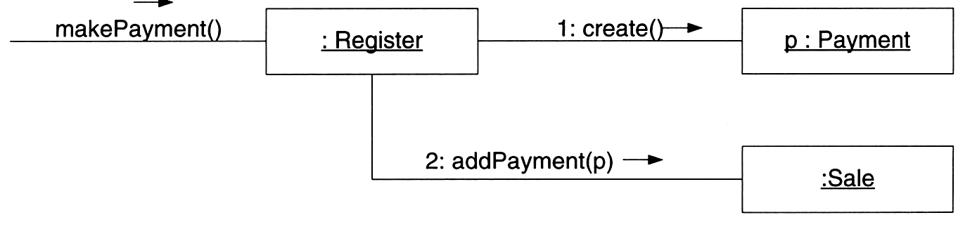
Example
Consider the following partial class diagram from a NextGEN case study:
Assume we have a need to create a Payment instance and associate it with the Sale. What class should be responsible for this?
Solution 1
  Since a Register “records” a Payment in the real-world domain, the Creator pattern suggests Register as a candidate for creating the Payment.
  The Register instance sends an addPayment message to Sale, passing along the new Payment as a parameter.
Payment
Register
Sale
Register creates Payment.

Slide 24
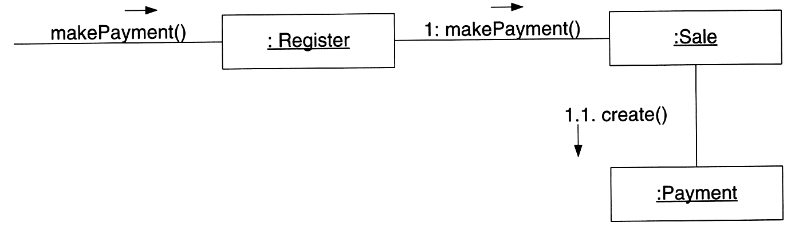
Example
Solution 2
  Create the Payment and associate it with the Sale.
Which solution is better?
  In both case, the Sale must eventually be coupled to knowledge of a Payment.
  Design 2 is preferable because overall lower coupling is maintained.
Sale creates Payment.

Slide 25
Discussion
Low Coupling is a principle to keep in mind during all design decisions.
Common forms of coupling from TypeX to TypeY:
  TypeX has an attribute that refers to a TypeY instance, or TypeY itself.
  A TypeX object calls on services of a TypeY object.
  TypeX has a method that references an instance of TypeY, or TypeY itself, by any means.
  TypeX is a direct or indirect subclass of TypeY.
  TypeY is an interface, and TypeX implements that interface.
A subclass is strongly coupled to its superclass.
There is no absolute measure of when coupling is too high.
X
Y

Slide 26
(4) High Cohesion
Solution
  Assign a responsibility so that cohesion remains high.
Problem
  How to keep complexity manageable?
Cohesion (functional cohesion)
  A measure of how strongly related and focused the responsibilities of an element are.
High cohesion elements (classes, subsystems, so on)
  Has high related responsibilities
  Does not do a tremendous amount of work
Low cohesion elements
  Do unrelated things, or do too much work.
  Often represent a very “large grain” of abstraction.
Problems of low cohesion element
  hard to comprehend
  hard to reuse
  hard to maintain
  delicate; constantly effected by change

Slide 27
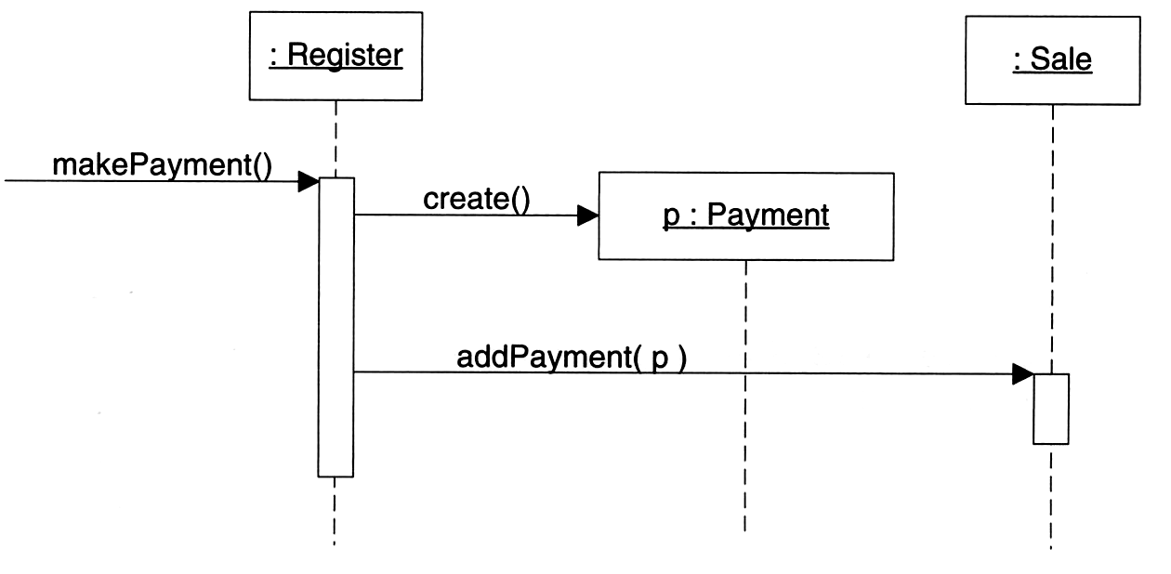
Example
Create a (cash) Payment instance and associate it with the Sale.
What class should be responsible for this?
  Since Register records a Payment in the real-world domain, the Creator pattern suggests Register as a candidate for creating the Payment.
But, if we continue to make the Register class responsible for doing some or most of the work related to more and more system operations, it will become increasingly burdened with tasks and become incohesive.
Register creates Payment.

Slide 28
(5) Controller
Problem
  Who should be responsible for handling an input system event?
Background
  An input system event is an event generated by an external actor.
  They are associated with system operations.
Solution
  Assign the responsibility for receiving or handling a system event message to a class (controller) representing one of the following choices:
    Represents the overall system, device, or subsystem (facade controller).
    Represents a use case scenario within which the system event occurs, often named <UseCaseName>handler, <UseCaseName>Coordinator, or <UseCaseName>Session (use-case or session controller).
Tips
  Use the same controller class for all system events in the same use case scenario.
  Informally, a session is an instance of a conversation with an actor. Session can be any length, but are often organized in terms of use cases (use case sessions).

Slide 29
Controller
Controller
  A non-user interface object responsible for receiving or handling a system event.
  Defines the methods for system operation.
Note
  “Windows”, “applet”, “view”, and “document” classes
    Not the controller.
    Receives the events and delegate them to a controller.
Example
  In the NextGen application, there are several system operations.
  The system itself is a class or component.
System
endSale()
enterItem()
makeNewSale()
makePayment()
…
System operations associated with the system events.

Slide 30
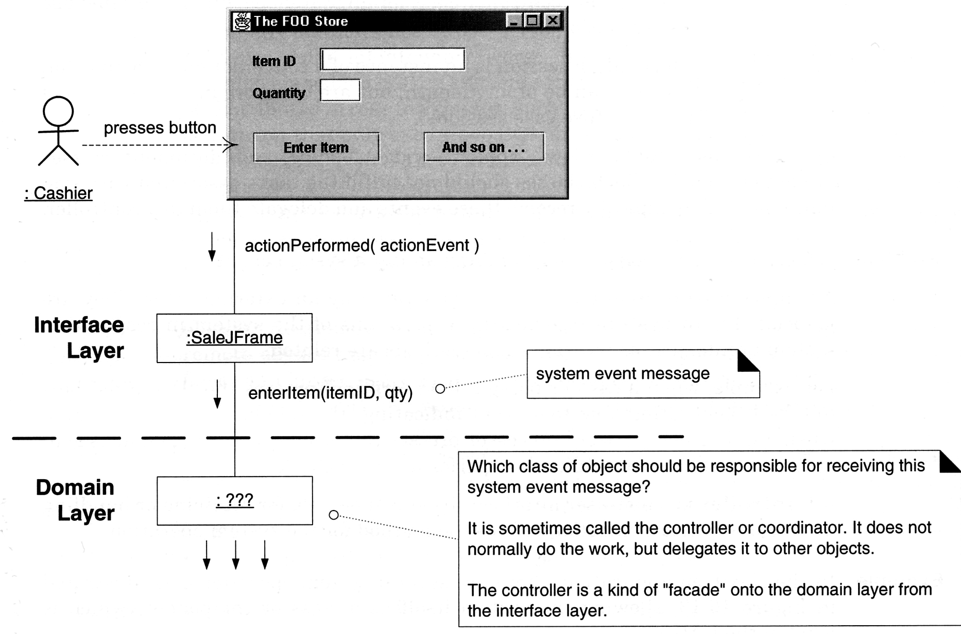
System class
During analysis, system operations may be assigned to the class System.
It does not mean that a software class named System fulfills them during design.
During design, a Controller class is assigned the responsibility for system operations.
Controller for enterItem?

Slide 31
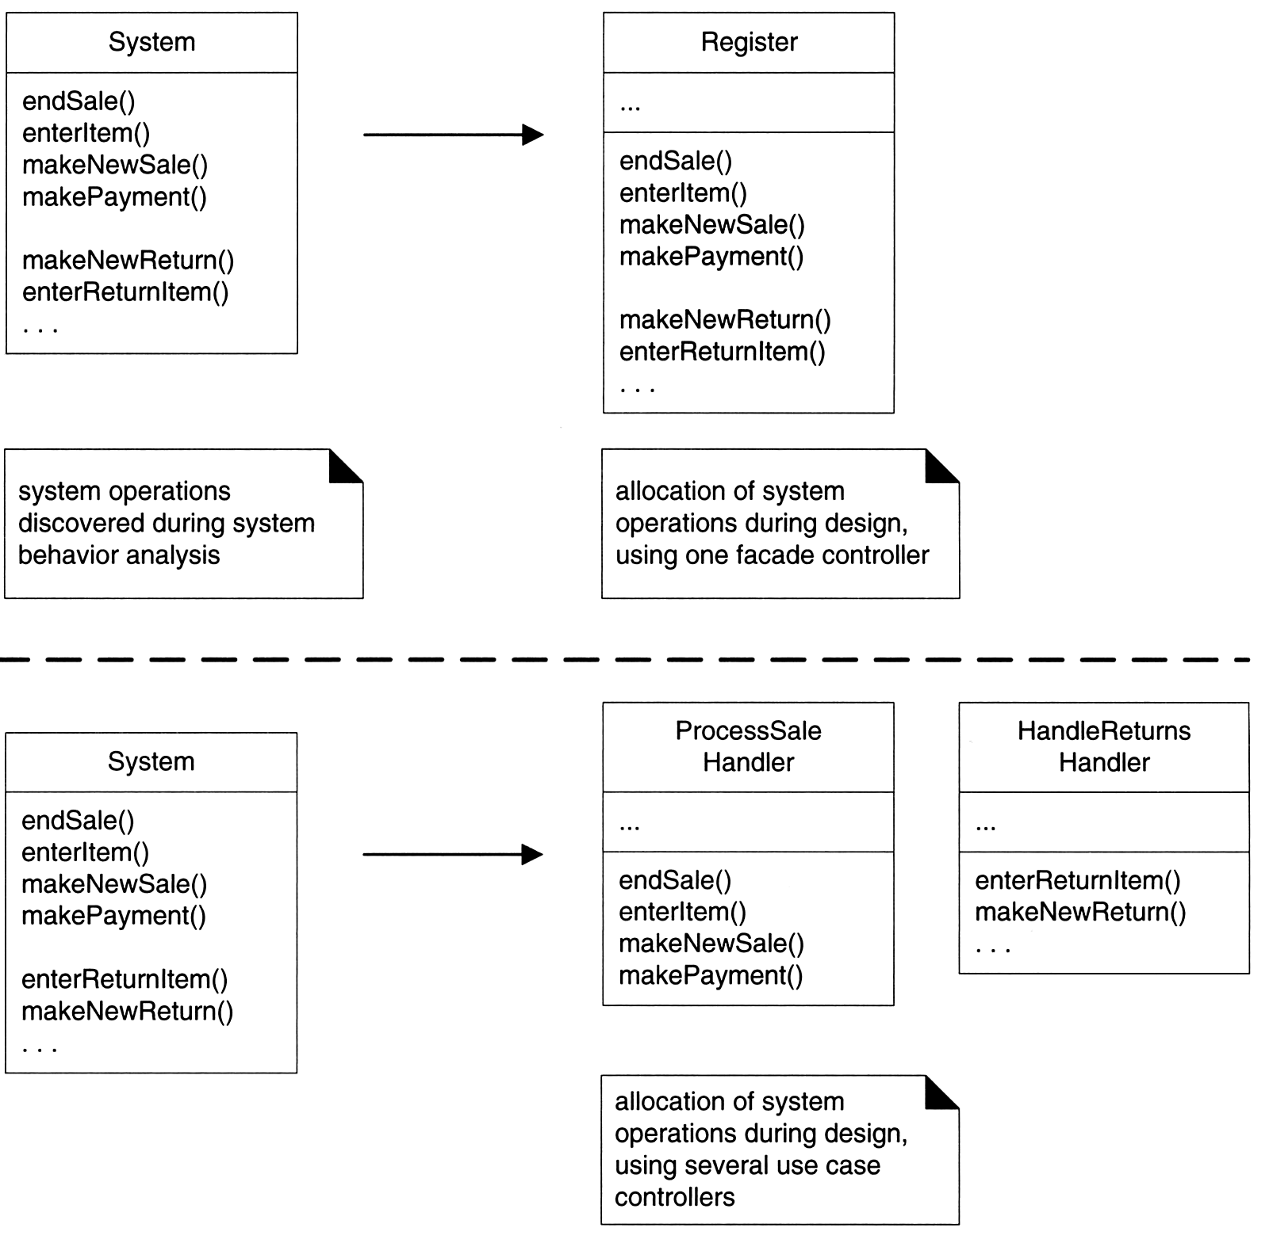
Choices of controllers
Handles all system events.
  Register, or POSSystem
Handles all system events of a use case scenario.
  ProcessSaleHandler, ProcessSaleSession
Allocation of system operations.

Slide 32
Bloated controllers
Bloated controller
  Poorly designed, low cohesion
  Unfocused and handling too many areas of responsibility
Signs of bloating
  There is only a single controller class receiving all system events.
  The controller itself performs many of the tasks necessary to fulfill the system event, without delegating the work.
    Usually involves a violation of Information Expert and High Cohesion.
  A controller has many attributes, and maintains significant information about the system or domain, which should be distributed to other objects, or duplicates information found elsewhere.
Solution for a bloated controller
  Add more controllers.
    Use use-case controllers.
  Design the controller so that it primarily delegates the fulfillment of each system operation responsibility on to other objects.

Slide 33
Other GRASP Patterns
  Polymorphism
  Pure fabrication
  Indirection
  Don’t talk to stranger

Slide 34
The Gang of Four

Slide 35
Categorising Design Patterns
Purpose
  Creational - concern the process of object creation, e.g.
    Abstract Factory, Singleton
  Structural - deal with the composition of classes and objects, e.g.
    Adapter, Facade
  Behavioural - characterise the way in which classes or objects interact and distribute responsibility, e.g.
    Iterator, Observer
Scope
  Class - the pattern is primarily concerned with classes, they deal with the relationships between classes and their sub-classes. These relationships are established through Inheritance and are static.
  Object - the pattern is primarily concerned with object relationships, which are more dynamic and can change at run-time

Slide 36
GofF Design Pattern Space
 |  | Purpose
 |  | Creational | Structural | Behavioral
Scope | Class | Factory method | Adapter Template Base | Interpreter Template Method
 | Object | Abstract Factory Builder Prototype Singleton | Adapter Bridge Composite Decorator Facade Flyweight Proxy | Chain of Responsibility Command Iterator Mediator Memento Observer State Strategy Visitor

Slide 37
Creational Patterns
Class
  Factory Method
    Define an interface for creating an object, but let subclasses decide which class to instantiate.
Object
  Abstract Factory
    Provide an interface for creating families of related objects without specifying their concrete classes.
  Builder
    Separate the construction of a complex object from its representation so that the same construction process can create different representations.
  Prototype
    Specify the kinds of objects to create using a prototypical instance, and create new objects by copying this prototype.
  Singleton
    Ensure a class only has one instance, and provide a global point of access to it.

Slide 38
Structural Patterns
Class
  Adapter
    Convert the interface of a class into another interface clients expect.
  Template Base
    Implement associations using template base classes
Object
  Adapter
    Convert the interface of a class into another interface clients expect.
  Bridge
    Decouple an abstraction from its implementation so that the two can vary independently (run-time inheritance)
  Composite
    Compose objects into tree structures to represent part-whole hierarchies. Composite lets clients treat individual objects and compositions of objects uniformly.

Slide 39
Structural Patterns (cont)
Object (cont)
  Decorator
    Attach additional responsibilities to an object dynamically.
  Facade
    Provide a unified interface to a set of interfaces in a subsystem.
  Flyweight
    Use sharing to support large numbers of fine-grained objects efficiently.
  Proxy
    Provide a surrogate or placeholder for another object to control access to it.

Slide 40
Behavioral Patterns
Class
  Interpreter
    Given a language, define a representation for its grammar along with an interpreter that uses the representation to interpret sentences in the language.
  Template Method
    Let subclasses redefine certain steps of an algorithm without changing the algorithm's structure.
Object
  Chain of Responsibility
    Avoid coupling the sender of a request to its receiver by giving more than one object a chance to handle the request.
  Command
    Encapsulate a request as an object.
  Iterator
    Provide a way to access the elements of an aggregate object sequentially without exposing its underlying representation.

Slide 41
Behavioral Patterns (cont)
Object (cont)
  Mediator
    Define an object that encapsulates how a set of objects interact.
  Memento
    Capture and externalize an object's internal state so that the object can be restored to this state later.
  Observer
    When one object changes state, all its dependents are notified and updated automatically.
  State
    Allow an object to alter its behavior when its internal state changes. The object will appear to change its class.
  Strategy
    Define a family of algorithms, encapsulate each one, and make them interchangeable.
  Visitor
    Represent an operation to be performed on the elements of an object structure.

Slide 42
Abstract Factory
( Creational Pattern )

Slide 43
Abstract Factory
Provides an interface for creating families of related or dependent objects without specifying their concrete classes
Abstract Factory has
  Purpose - Creational
  Scope - Object

Slide 44
Abstract Factory Example
Client
WidgetFactory
CreateScrollBar()
CreateWindow()
Window
Win 7
Window
Mac
Window
CreateScrollBar()
CreateWindow()
CreateScrollBar()
CreateWindow()
WinMacWidgetFactory
Win7WidgetFactory
ScrollBar
creates
Win 7
ScrollBar
Mac
ScrollBar
creates

Slide 45
Applicability
Use when:
  a system should be independent of how its products are created, composed, and represented
  a system should be configured with one of multiple families of products.
  a family of related product objects is designed to be used together, and you need to enforce this constraint.
  you want to provide a class library of products, and you want to reveal just their interfaces, not their implementations.
  you want to hide and reuse awkward or complex details of construction

Slide 46
The Structure of Abstract Factory
Client
AbstractFactory
CreateProductA()
CreateProductB()
AbstractProductA
ProductA2
ProductA1
CreateProductA()
CreateProductB()
CreateProductA()
CreateProductB()
ConcreteFactory1
ConcreteFactory2
Abstract ProductB
creates
ProductB2
ProductB1
creates

Slide 47

Participants(1)
AbstractFactory
  declares an interface for operations that create product objects.
ConcreteFactory
  implements the operations to create concrete product objects.

Slide 48
Participants(2)
AbstractProduct
  declares an interface for a type of product object.
Product
  defines a product to be created by the corresponding concrete factory.
  implements the AbstractProduct interface.

Slide 49
Participants(3)
Client
  uses only interfaces declared by AbstractFactory and AbstractProduct classes.

Slide 50
Example
Building a maze for a computer game.
A Maze is a set of Rooms.
A Room knows its neighbours.
  another room
  a wall
  a door

Slide 51
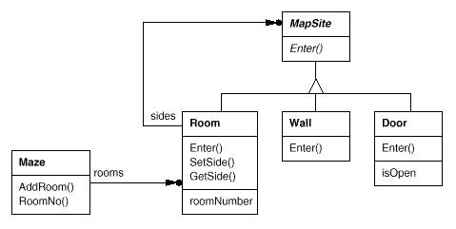
Maze Structure

Slide 52
Creating Mazes
public class MazeGame
{
public static void main(String args[]) {
Maze m = new MazeGame().createMaze();
}
public Maze createMaze() {
Room r1 = new Room(1);
Room r2 = new Room(2);
Door d = new Door(r1,r2);
r1.setSide(Direction.North, new Wall());
r1.setSide(Direction.East, d);
r1.setSide(Direction.West, new Wall());
r1.setSide(Direction.South, new Wall());
r2.setSide(Direction.North, new Wall());
r2.setSide(Direction.West, d);
r2.setSide(Direction.East, new Wall());
r2.setSide(Direction.South, new Wall());
Maze m = new Maze();
m.addRoom(r1);
m.addRoom(r2);
return m;
}
}
d
r1
r2

Slide 53
Creational Patterns Benefits
Will make the maze more flexible.
  easy to change the components of a maze
  e.g., DoorNeedingSpell, EnchantedRoom
    How can you change createMaze() so that it creates mazes with these different kind of classes?
    Biggest obstacle is hard-coding of class names.

Slide 54
Sample Code
public class MazeFactory {
Maze makeMaze() { return new Maze(); }
Wall makeWall() { return new Wall(); }
Room makeRoom(int r) { return new Room(r); }
Door makeDoor(Room r1, Room r2) { return new Door(r1,r2);}
}

Slide 55
Maze Creation (old way)
public Maze createMaze() {
Room r1 = new Room(1);
Room r2 = new Room(2);
Door d = new Door(r1,r2);
r1.setSide(Direction.North, new Wall());
r1.setSide(Direction.East, d);
r1.setSide(Direction.West, new Wall());
r1.setSide(Direction.South, new Wall());
r2.setSide(Direction.North, new Wall());
r2.setSide(Direction.East, d);
r2.setSide(Direction.West, new Wall());
r2.setSide(Direction.South, new Wall());
Maze m = new Maze();
m.addRoom(r1);
m.addRoom(r2);
return m;
}

Slide 56
Sample Code
public Maze createMaze(MazeFactory factory) {
Room r1 = factory.makeRoom(1);
Room r2 = factory.makeRoom(2);
Door d = factory.makeDoor(r1,r2);
r1.setSide(Direction.North, factory.makeWall());
r1.setSide(Direction.East, d);
r1.setSide(Direction.West, factory.makeWall());
r1.setSide(Direction.South, factory.makeWall());
r2.setSide(Direction.North, factory.makeWall());
r2.setSide(Direction.East, d);
r2.setSide(Direction.West, factory.makeWall());
r2.setSide(Direction.South, factory.makeWall());
Maze m = factory.makeMaze()
m.addRoom(r1);
m.addRoom(r2);
return m;
}

Slide 57
Sample Code
public class EnchantedMazeFactory extends MazeFactory {
public Room makeRoom(int r) {
return new EnchantedRoom(r, castSpell());
}
public Door makeDoor(Room r1, Room r2) {
return new DoorNeedingSpell(r1,r2);
}
private protected castSpell() {
// randomly choose a spell to cast;
…
}
}

Slide 58
Sample Code
public class MazeGame
{
public static void main(String args[]) {
Maze m = new MazeGame().createMaze(new MazeFactory());
}
}
public class MazeGame
{
public static void main(String args[]) {
Maze m = new MazeGame().createMaze(new EnchantedMazeFactory());
}
}

Slide 59
Consequences
It isolates concrete classes
It makes exchanging product families easy
It promotes consistency among products
Supporting new kinds of products is difficult.

Slide 60
Observer
( Behavioral Pattern )

Slide 61
Observer
Defines a one-to-many dependency between objects so that when one object changes state, all its dependents are notified and updated automatically
Observer has
  Purpose - Behavioural
  Scope - Objects

Slide 62
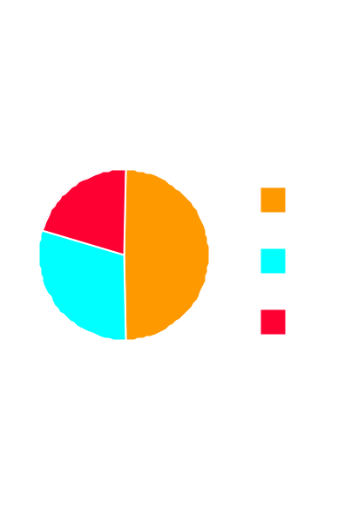
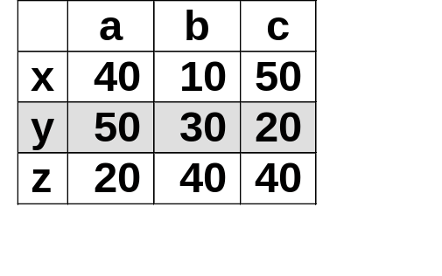
Motivation
observers
Table
X
Bar Chart
X
Pie Chart
X
a b c
a = 50%
b = 30%
c = 20%
requests, modifications
change notification
subject
Separate presentation aspects of the UI from the underlying application data.
  e.g., spreadsheet view and bar chart view don't know about each other
    they act as if they do: changing one changes the other.

Slide 63
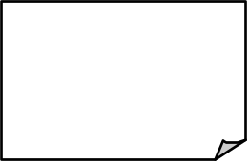
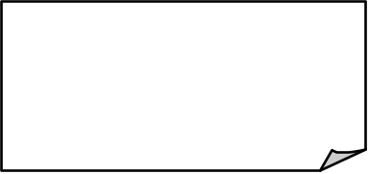

The Structure of Observer
Subject
Observer
Update()
Attach(Observer)
Detach(Observer)
Notify()
observers
*
For all o in
observers{
o->Update() }
ConcreteSubject
ConcreteObserver
GetState()
SetState()
Update()
subject
observerState =
subject -> GetState()
subjectState
Return
subjectState
observerState

Slide 64
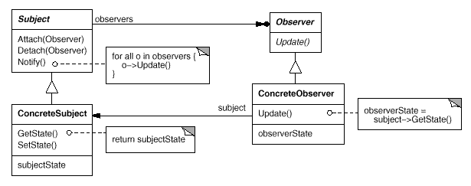
Participants (1)
Subject
  knows its observers
  any number of Observers may observe one subject
Observer
  defines an updating interface for objects that should be notified of changes to the subject

Slide 65
Participants (2)
Concrete Subject
  stores the state of interest to ConcreteObservers
  send notification when its state changes
Concrete Observer
  maintains a reference to the ConcreteSubject objects
  stores state that should remain consistent with subject's
  implements the Observer updating interface

Slide 66
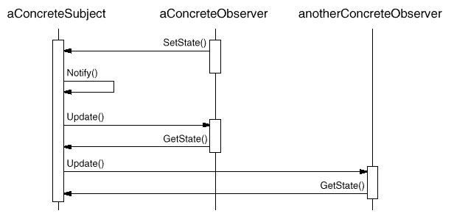
Collaborations

Slide 67
Applicability
When an abstraction has two aspects, one dependent upon the other
  e.g., view and model
Encapsulating these aspects into separate objects lets you vary them independently.
When a change to one object requires changing others, and you don't know ahead of time how many there are or their types

Slide 68
Consequences
Abstract Coupling between Subject and Observer
Support for Broadcast Communication
Unexpected Updates

Slide 69
Sample Code
Class Subject;
Class Observer {
public:
virtual ~Observer();
virtual void Update(Subject* theChangeSubject) = 0;
protected:
Observer() ;
};

Slide 70
Sample Code
Class Subject {
public:
virtual ~Subject();
virtual void Attach(Observer*);
virtual void Detach(Observer*);
virtual void Notify();
protected:
Subject();
private:
List<Observer*> *_observers;
};

Slide 71
Sample Code
void Subject::Attach(Observer* o) {
_observers->Append(o);
}
void Subject::Detach(Observer* o) {
_observers->Detach(o);
}
void Subject::Notify() {
ListIterator<Observer*> i(_observer);
for (i.first(); !i.IsDone(); i.Next() ) {
i.CurrentItem()->Update(this);
}
}

Slide 72
Known Uses
Smalltalk
  Model-View-Controller (MVC)
User Interface Tools - Interviews, Andrew Toolkit and Unidraw
  View vs. Subject

